Slide 1

Future background scenarios in LCA
Center for Nuclear Engineering and Sciences
Center for Energy and Environmental Sciences
Romain Sacchi
Laboratory for Energy Systems Analysis
Paul Scherrer Institute, Switzerland
Grosshöchstetten, 12 November 2024

Slide 2
Talk content
Definition of scenarios
Foreground vs. background scenarios
Integrated Assessment Models
PREMISE workflow and open-source tools
Effects of temporally-adjust inventories
Study cases using temporally-adjusted background LCA
Upcoming developments
System-wide prospective LCA
Notes:
I would like to focus in this talk on background scenarios.
Background prospective scenarios are different from foreground prospective scenarios.
For some foreground systems, the background does not matter much.
But others are very much influenced by what is happening in the rest of the economy.

Slide 3
What is a scenario?
A scenario is a description of how the future may develop, based on a coherent and internally consistent set of assumptions…
about key drivers including demography, economic processes, technological innovation, governance, lifestyles, and relationships among these driving forces (IPCC 2021)

Slide 4

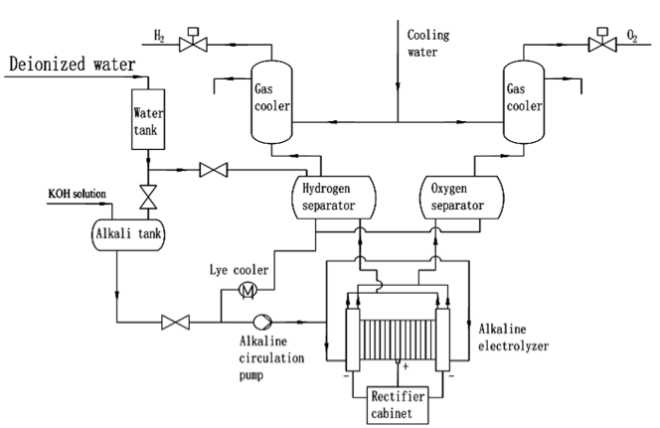
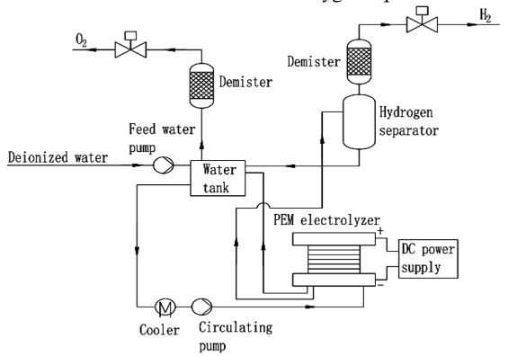
Different kinds of scenarios
Broad (global) scenarios
For the global economy (CGE models, IAM)
Relevant for prospective LCAs in general
Background scenarios
Narrow (local) scenarios
For specific technologies (hydrogen)
Limited to a specific prospective LCA
Foreground scenarios
vs
Yujing Guo et al 2019

Slide 5




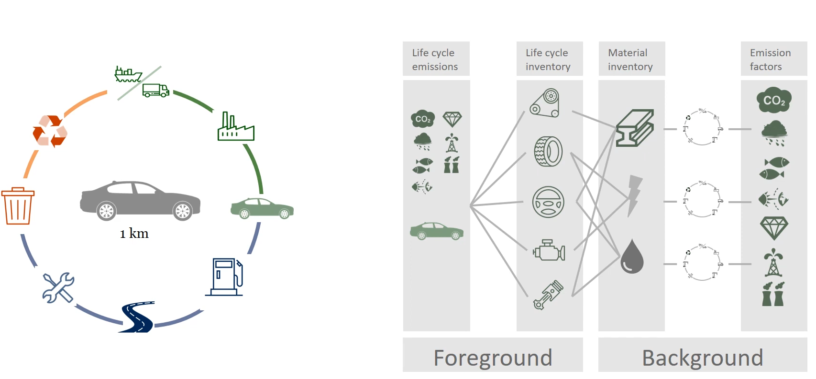






Background (LCA database)
LCA is about systematically accounting for environmental impacts associated with a service, considering supply chain relations between processes.
Foreground
pLCA is about projecting changes in process efficiency and supply chain relations, both in foreground and background, following on a coherent storyline.
Notes:
0. We typically distinguish the foreground from the background data structure in life-cycle modelling
Foreground modelling: comprises the process the system under study directly affects or is supported by.
Background modelling: ancillary services and commodities (metals, electricity heat).

Slide 6









Terminology “pLCI database”
pLCI database = prospective life cycle inventory database
The difference with a regular LCI database is that it represents the economy, industrial activities, and trade for a future point in time under a given scenario.
Current
2030
2050 2100

Slide 7
The history of scenario-based prospective LCA
Gibon et al.
THEMIS (IEA scenarios → ecoinvent 2.2)
C. Mutel
wurst
Luderer et al.
(REMIND → ecoinvent 3 → REMIND)
Knobloch et al.
(E3ME-FTT-GENIE → ecoinvent 3)
J. Joyce
Futura
Tighter PREMISE integration with Brightway and Activity Browser
2015
2017
2018
2019
2020
2022
2024
Pehl et al.
THEMIS (REMIND scenarios → ecoinvent 3)
Mendoza et al.
(IMAGE scenarios → ecoinvent 3)
Cox et al.
(IMAGE scenarios → ecoinvent 3)
Sacchi et al.
PREMISE
(IAM scenarios → ecoinvent 3)
Diepers, Müller & Jakobs
bw_timex
Tool
Method

Slide 8
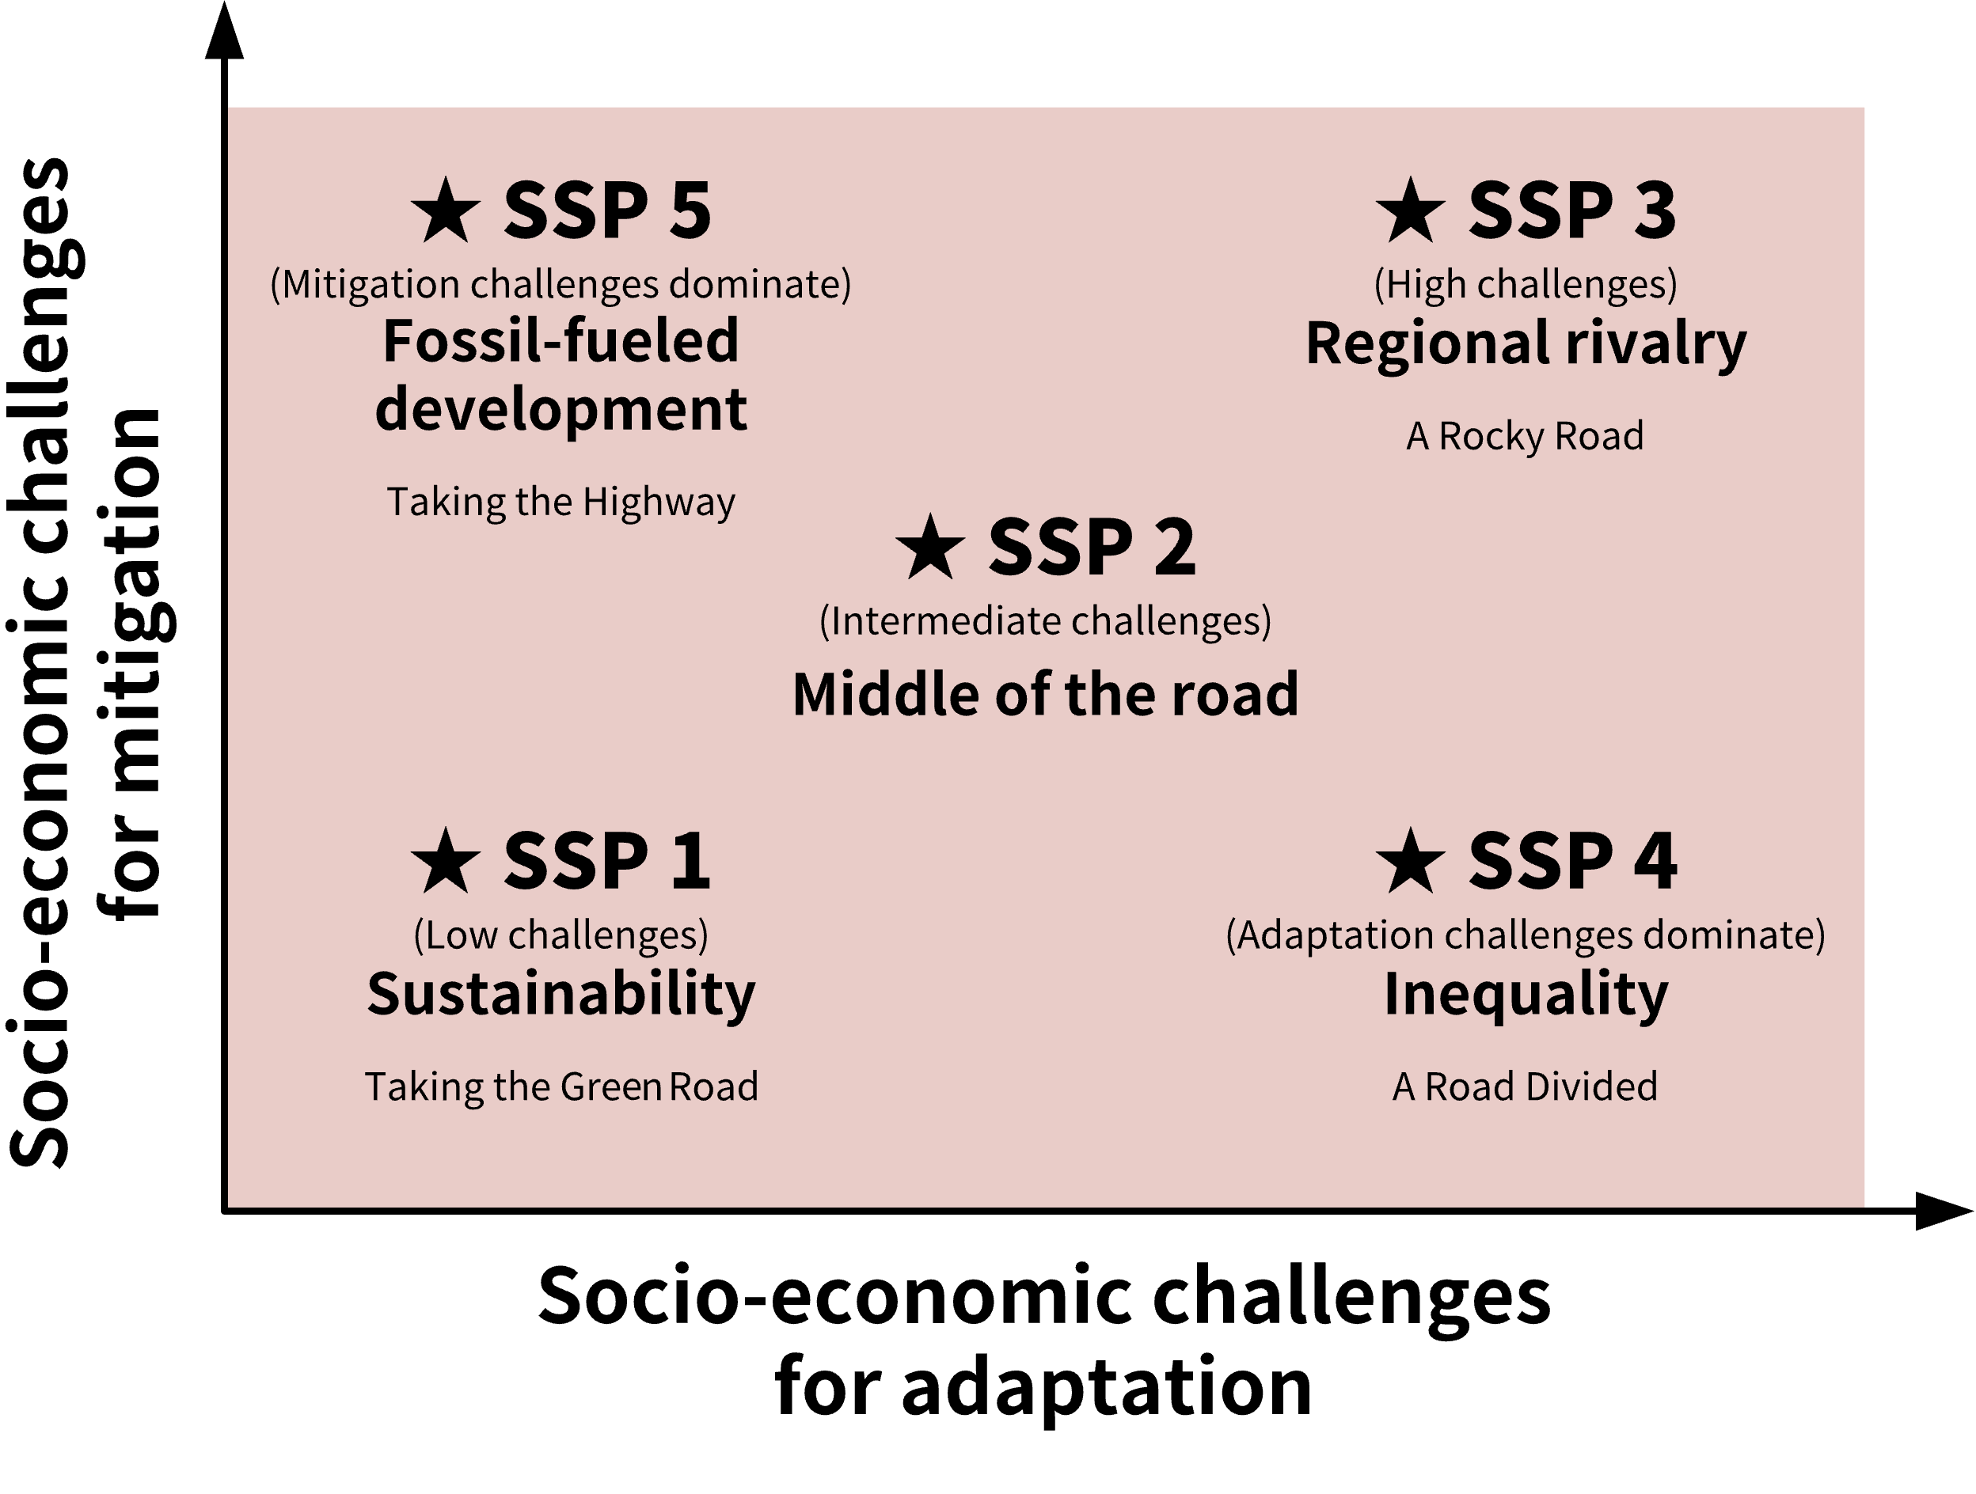
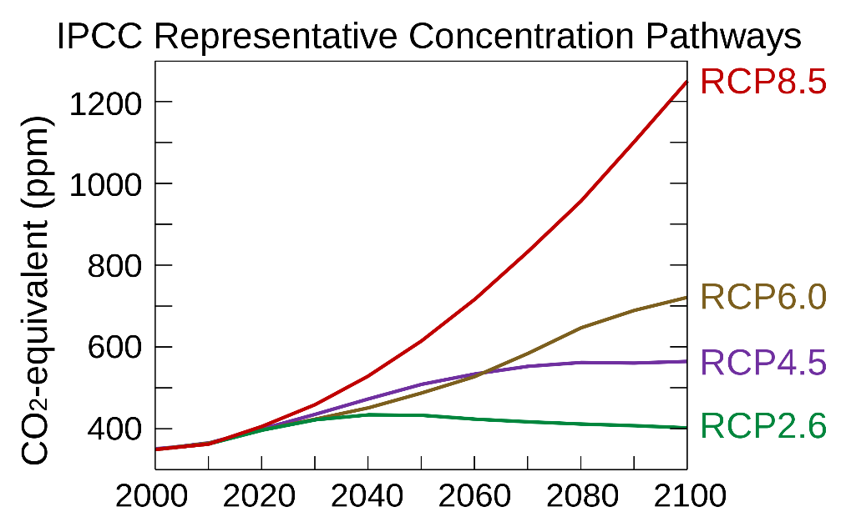
A short and incomplete history of pLCI databases
NEEDS project (2004-2009)
First systematic approach to generate future scenarios of the ecoinvent database (electricity supply and other sectors)
THEMIS model (Gibon 2015; Hertwich 2015)
Hybrid (MRIO-LCA) model including IEA energy and NEEDS scenarios
“When background matters” (Mendoza and Cox 2018)
Combine data from the integrated assessment model IMAGE and ecoinvent (focus electricity supply)
IAMs model SSPs (Shared Socio-economic Pathways) and RCPs (representative concentration pathways)
wurst: python package for systematic modifications of LCI databases (Mutel, 2017)
premise (Sacchi 2022)
python package for generating pLCI databases
Strongly based on IAM data (IMAGE, REMIND)
Electricity, steel, cement, transport, fuel
Notes:
SSP = global story lines
RCP = GHG concentration trajectories adopted by the IPCC describing different climate futures
The modeling of future background scenarios goes back at least to the NEEDS project, which has developed future scenarios for the European electricity supply more than 10 years ago. Later the THEMIS model was developed, which combined LCA with MRIO data and included scenarios of future electricity supply and other sectors. Then in 2018, Mendoza and colleagues coupled the Integrated Assessment Model IMAGE to the ecoinvent database to derive future versions of ecoinvent with a focus on electricity supply. This work is very interesting for two reasons: 1) it combines data from IAMs with LCA. IAMs model global future scenarios with detailed technology descriptions for important sectors. IAMs also implement the widely accepted Shared Socioeconomic Pathway scenarios. Thus using IAM data to generate scenarios for LCA takes some of the burden of generating scenarios from the LCA community. 2) the models were combined in a programmatic way using dedicated python libraries. This has several advantages, e.g. concerning reproducibility and transparency, but also the possibility to further extend and improve these libraries in future work. Lately, Sacchi and colleagues have extended this work in the PREMISE framework and further increased the sectoral coverage.

Slide 9



















INTEGRATED ASSESSMENT MODELS (IAM) vs. LCA
Page 9
Current
2030
2050 2100
Current
October 2nd, 2024

Slide 10





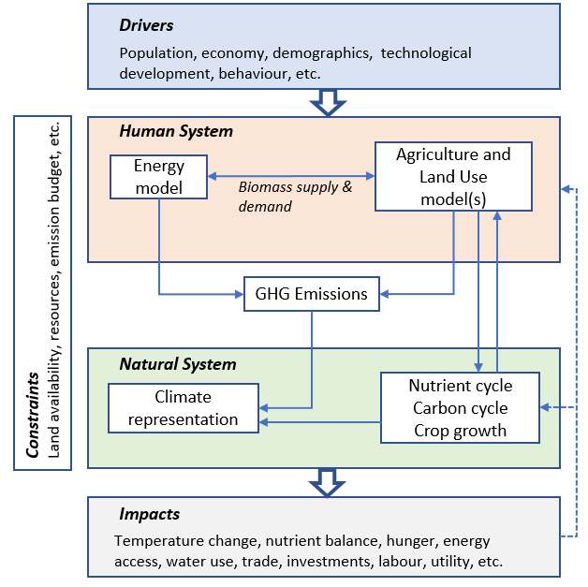

INTEGRATED ASSESSMENT MODELS (IAM)
REMIND
IMAGE
GCAM
MESSAGE_{ix}
TIAM-UCL
Integrated Assessment Models (IAMs) assess the interactions between human and natural systems
Contain stylized representations of
Energy system
Agricultural economy
Climate
Land system
Bridge the Science/Policy interface
Scenario Analysis: What if?
What are the drivers or constraints of change?
How do technology and policy choices lead to different outcomes?
Uncertainties? Sensitivities?

Slide 11
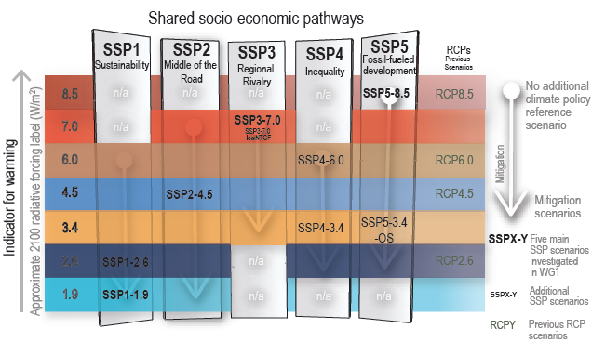






INTEGRATED ASSESSMENT MODELS (IAM)
Global regionalized models that consider broad socio-economic and technological developments and their consequences over time.
Used to inform policymakers on climate change and other environmental or socio-economic criteria.
No additional climate policy
(~5 °C warming by 2100)
Shared-Socioeconomic Pathways (SSPs)
Representative Concentration Pathways (RCPs)
IPCC 2021
Paris agreement (~1.5 °C warming by 2100)

Slide 12
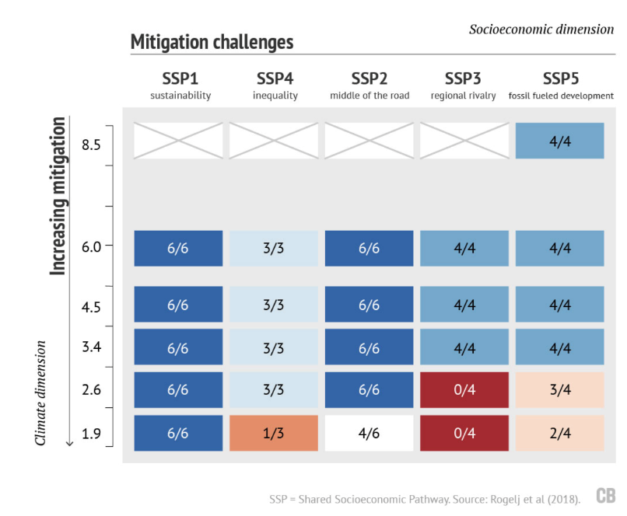
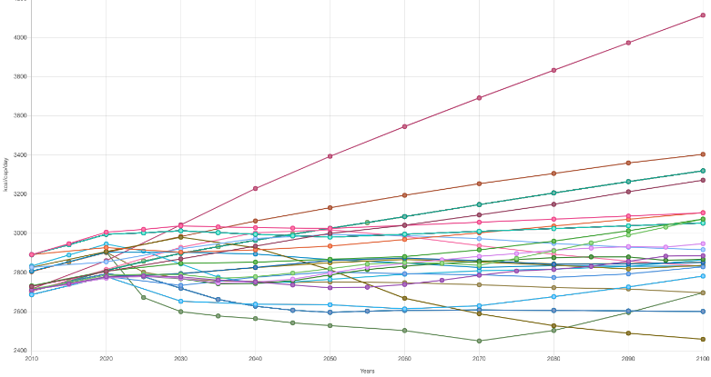
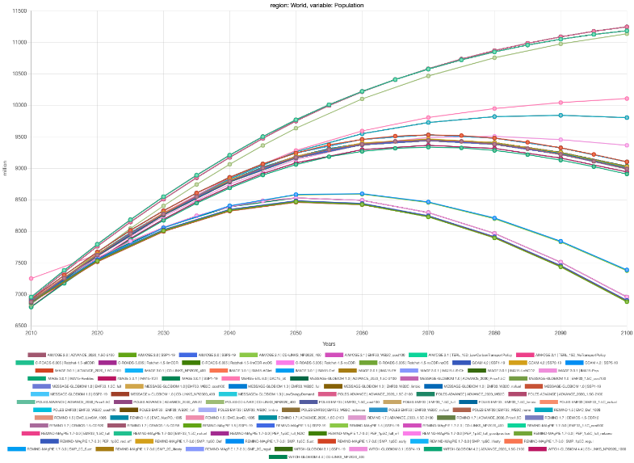
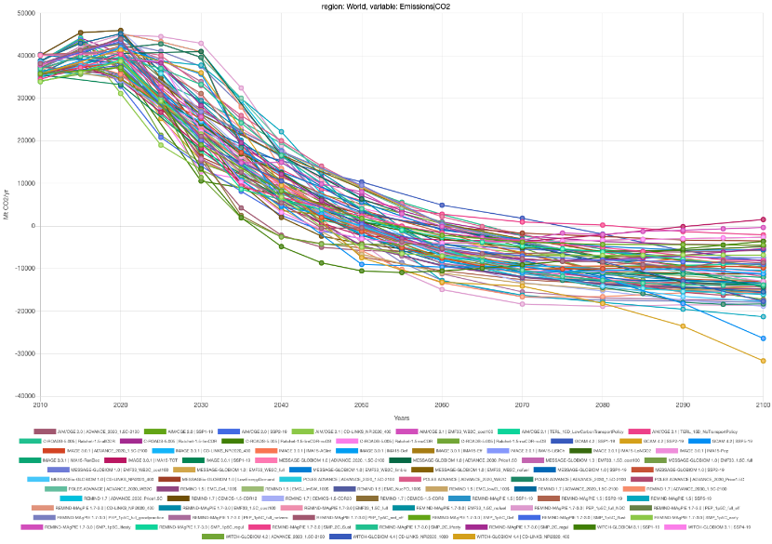
Socio-economic and climate constraints
Socio-economic constraints (SSP)
Food demand
Population
Climate constraints (RCP)
CO₂-eq emissions
Global Mean Surface Temp. Increase
Credit: CarbonBrief, Zeke Hausfather, 2018. https://www.carbonbrief.org/explainer-how-shared-socioeconomic-pathways-explore-future-climate-change

Slide 13
Projections on energy-intensive sectors
For each time step:
Technology investments
Capacity build-up
Generation
Link to dashboard

Slide 14

















Premise: the workflow
1
No climate policy
2
3
REMIND
Paris Agreement target
IMAGE
Nationally-determined contributions
Regional rivalry
System LCA
TIAM-UCL
…
Additional inventories
Process LCA
5
4

Slide 15
Premise workflow
Steps
1) Input data: future scenarios from IAMs and the LCI database ecoinvent
2) Integration of future scenario data with the LCI database via premise
3) Export of pLCI databases in various formats
4 & 5) optional feedback of environmental indicators to IAMs
1
No climate policy
2
3
REMIND
Paris Agreement target
IMAGE
Nationally-determined contributions
Push for biofuels
MESSAGE_{ix}
Superstructure
Wurst
Constructive geometries
Additional inventories to represent emerging technologies
5
4

Slide 16
Premise workflow: Open-source python packages
Brightway: LCA framework
Wurst: systematic transformations of LCI datasets
Constructive geometries: handling of ecoinvent geographies
Premise: integration software for IAM (and other) data with LCI databases
Superstructure approach: conversion of multiple LCI databases into a single LCI database (superstructure) and a scenario difference file [based on Brightway]
Activity Browser: graphical user interface to Brightway; implements “scenario-LCA” based on superstructure approach [based on brightway]
1
No climate policy
2
3
REMIND
Paris Agreement target
IMAGE
Nationally-determined contributions
Push for biofuels
MESSAGE_{ix}
Superstructure
Wurst
Constructive geometries
Additional inventories to represent emerging technologies
5
4

Slide 17
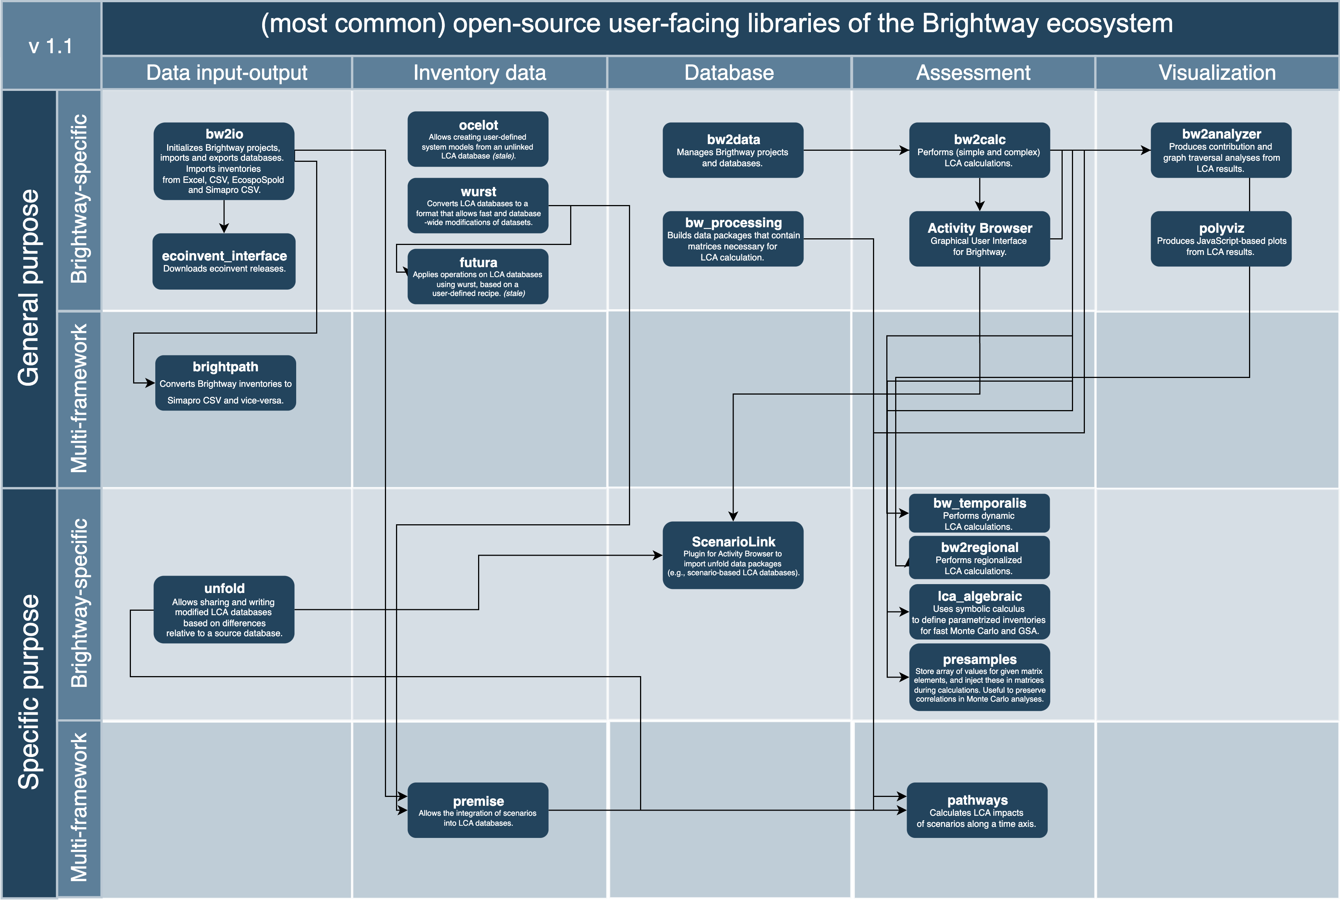
OVERVIEW of open-source tools in the BRIGHTWAY ecosystem

Slide 18










What does premise do?
ongoing
Power
Create regional electricity markets
Adjust power plant efficiency
Fuels
Create regional fuel markets Add new production pathways (synthetic fuels)
Metals recycling
Adjust critical raw materials use
Adjust future recycled content
Hot pollutant emissions
Adjust hot pollutant emission
from GAINS
80%
Renewables
Adjust solar PV and wind turbines efficiency
Transport
Create market for passenger
and freight road transport
Industry
Adjust efficiency for cement and steel production (fuel mix, process efficiency, material composition, etc.)
Carbon capture and storage
Add carbon capture and
storage where needed

Slide 19















Statistics on premise
GaAs, Perovskite, …
FT fuels
Biofuels
Power with CCS
Geothermal, wave, …
Fuel cell: PEM, AEFC, SOFC, DMFC
Electrolyzer: PEM, AE, SOE
Batteries: LiB, SiB
Trucks: EV, FC
Cars: EV, FC
+2’300 datasets
Peer-reviewed
Documented
EI 3.6-3.10
Trains: PEM, D, EV, FC
Chemicals: MeOH, NH3
Metals: PGM, Li, Co
CDR: DACCS, BECCS

Slide 20
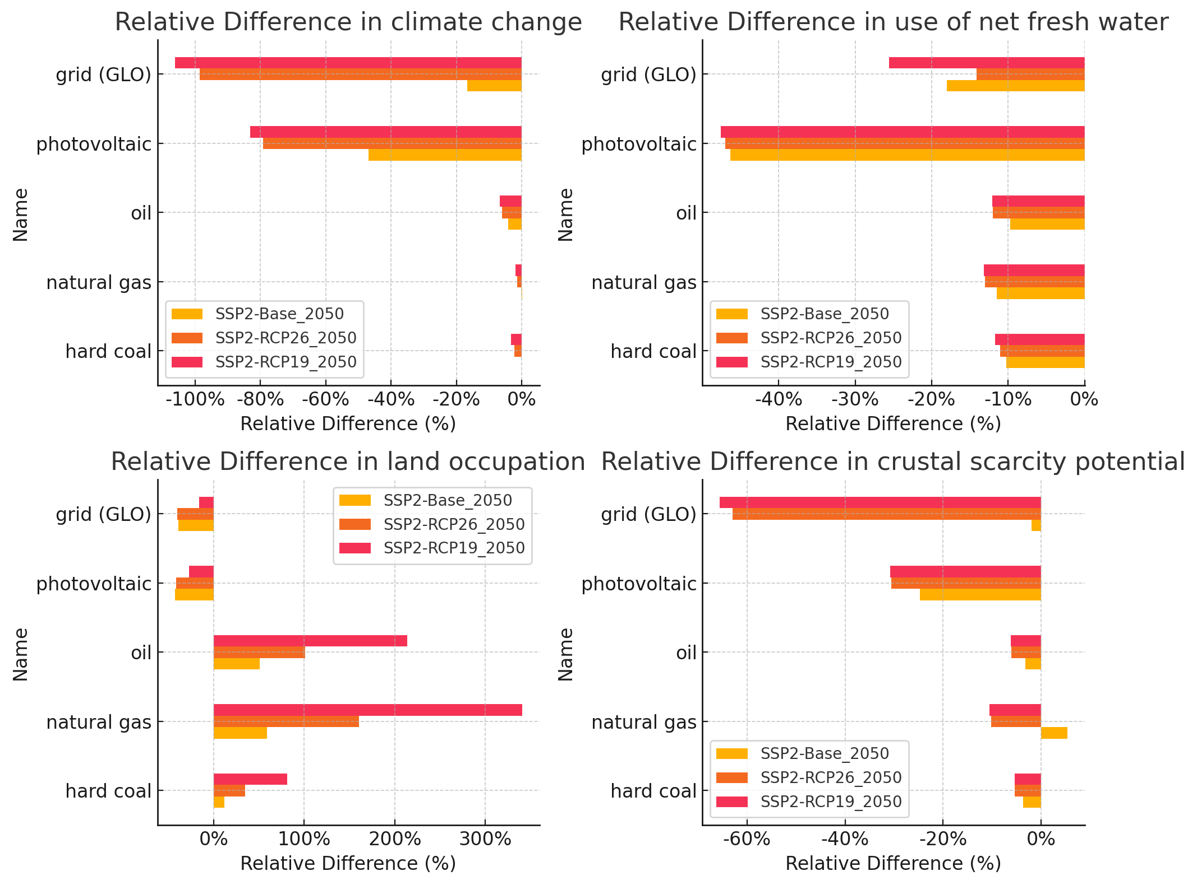




Example of SECTOR-SPECIFIC transformation: power generation
LCA
IAM
LCA
Modelling new power plants
Efficiency
Scores relative to original Ecoinvent values
40%
Hard coal
Lignite
Natural gas
Fuel oil
…
1 kWh
20%
2020
2050
Pollutants
SO_{x} , NO_{x}, VOC, …
4 mg
1 kWh
2 mg
2020
2050
Market mixes
Relinking
Steel
2050
USA
Market
USA
USA
Farming
USA

Slide 21





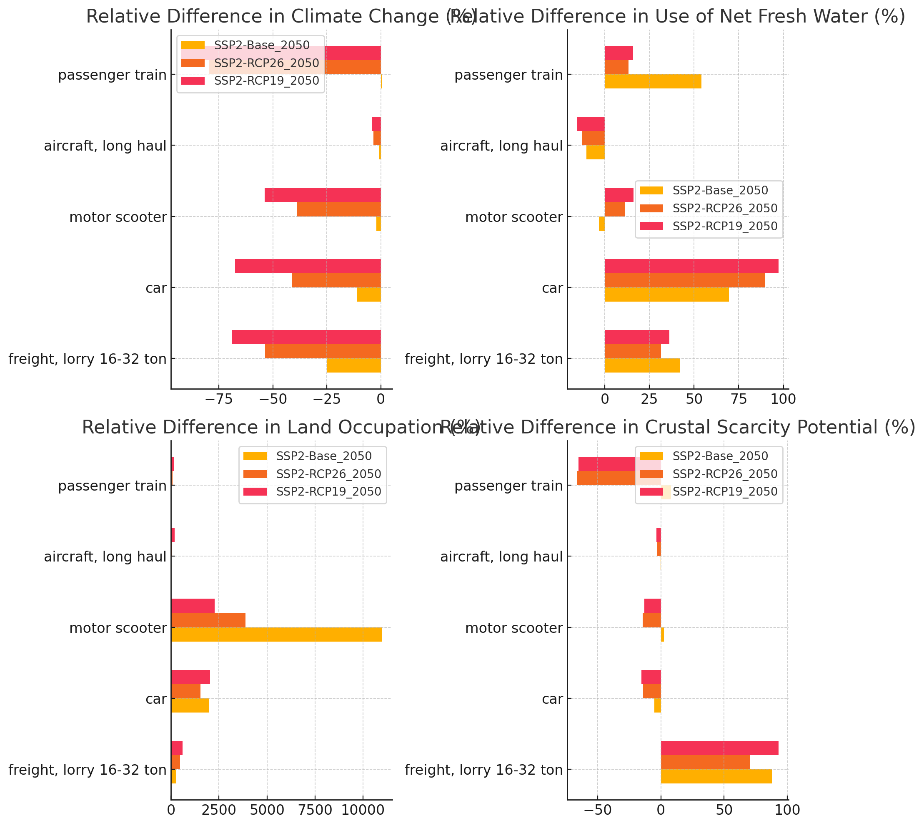






Example of SECTOR-SPECIFIC transformation: TRANSPORT
LCA
Scores relative to original Ecoinvent values
Modelling new vehicles
IAM
LCA
Efficiency
40%
20%
2020
2050
Adjust fuel mixes
CO₂
Market mixes
Relinking
Steel
Market
USA
USA
Farming
USA

Slide 22


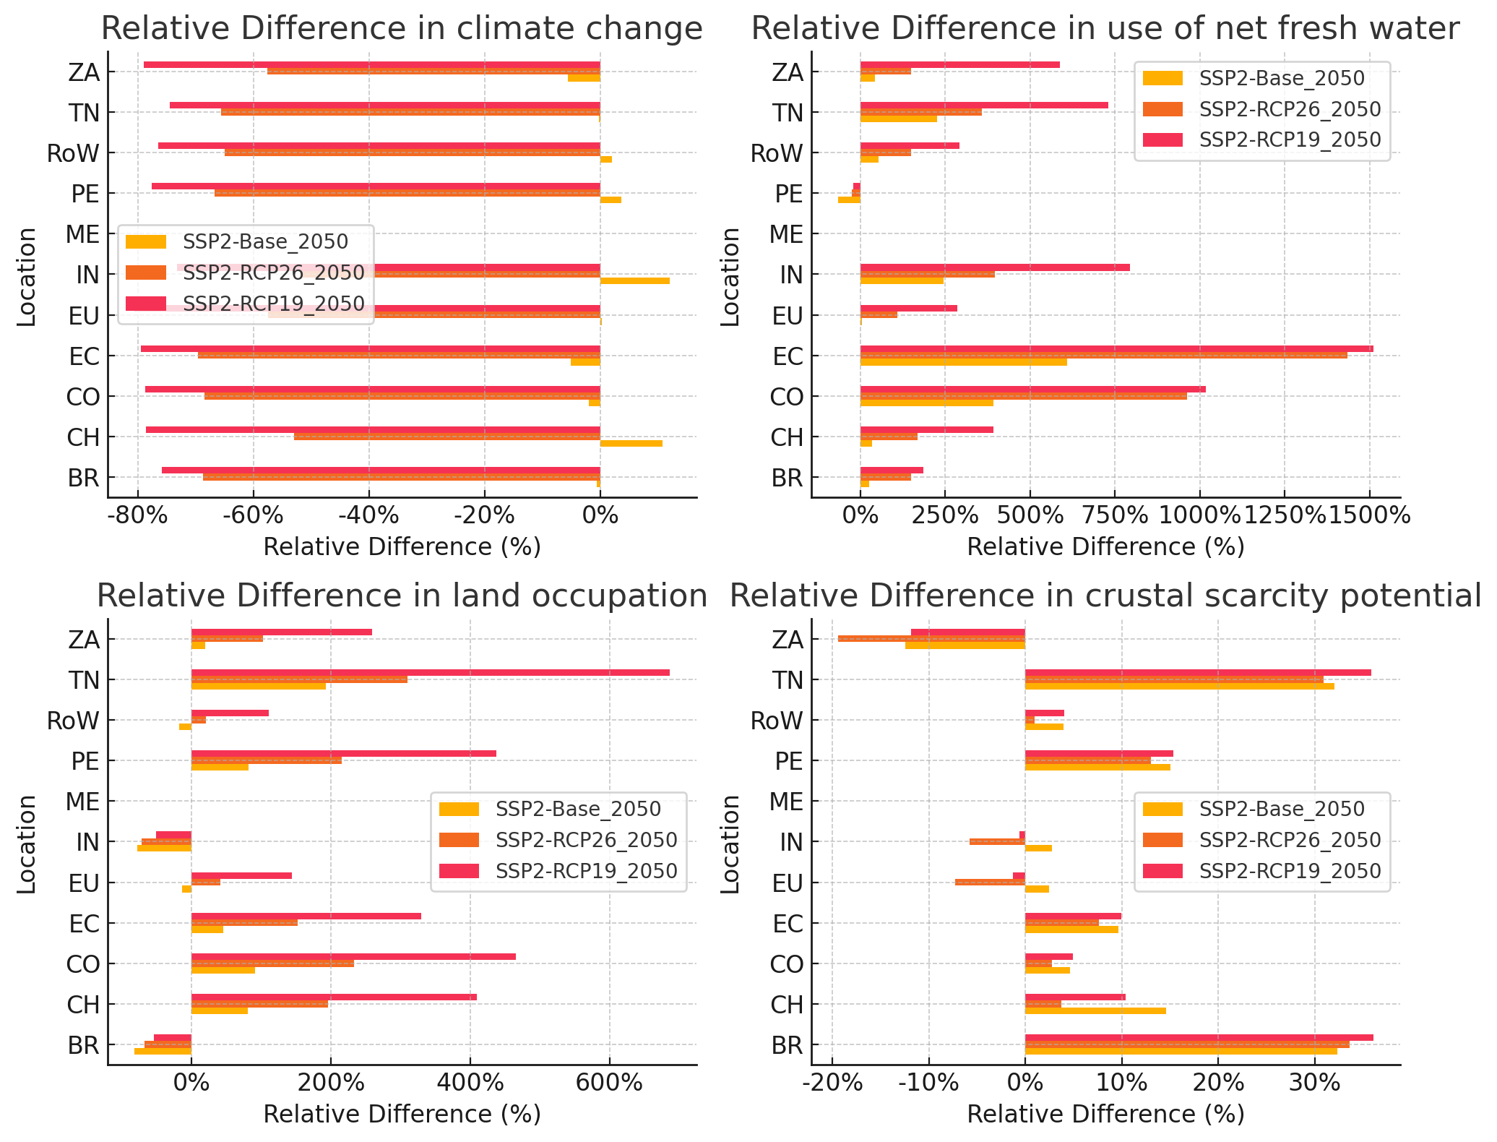





Example of SECTOR-SPECIFIC transformation: CEMENT
LCA
Modelling new kiln technologies
Scores relative to original Ecoinvent values
Efficient kiln
CCS (MEA)
CCS (Oxyfuel)
CCS (Direct Separation)
IAM
LCA
Specific energy use
4.5
3.0
2020
2050
Adjust fuel mixes
CO₂
Market mixes
Relinking
Concrete
CCS (DS)
Market
EUR
CCS (MEA)
EUR
Mortar
CCS (Oxy)
EUR

Slide 23
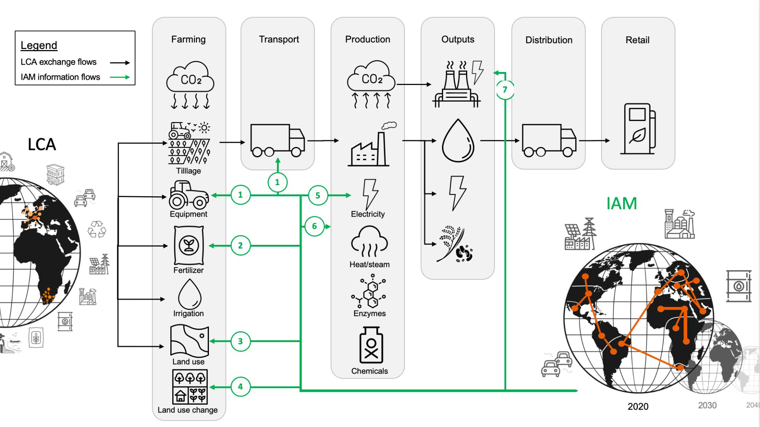
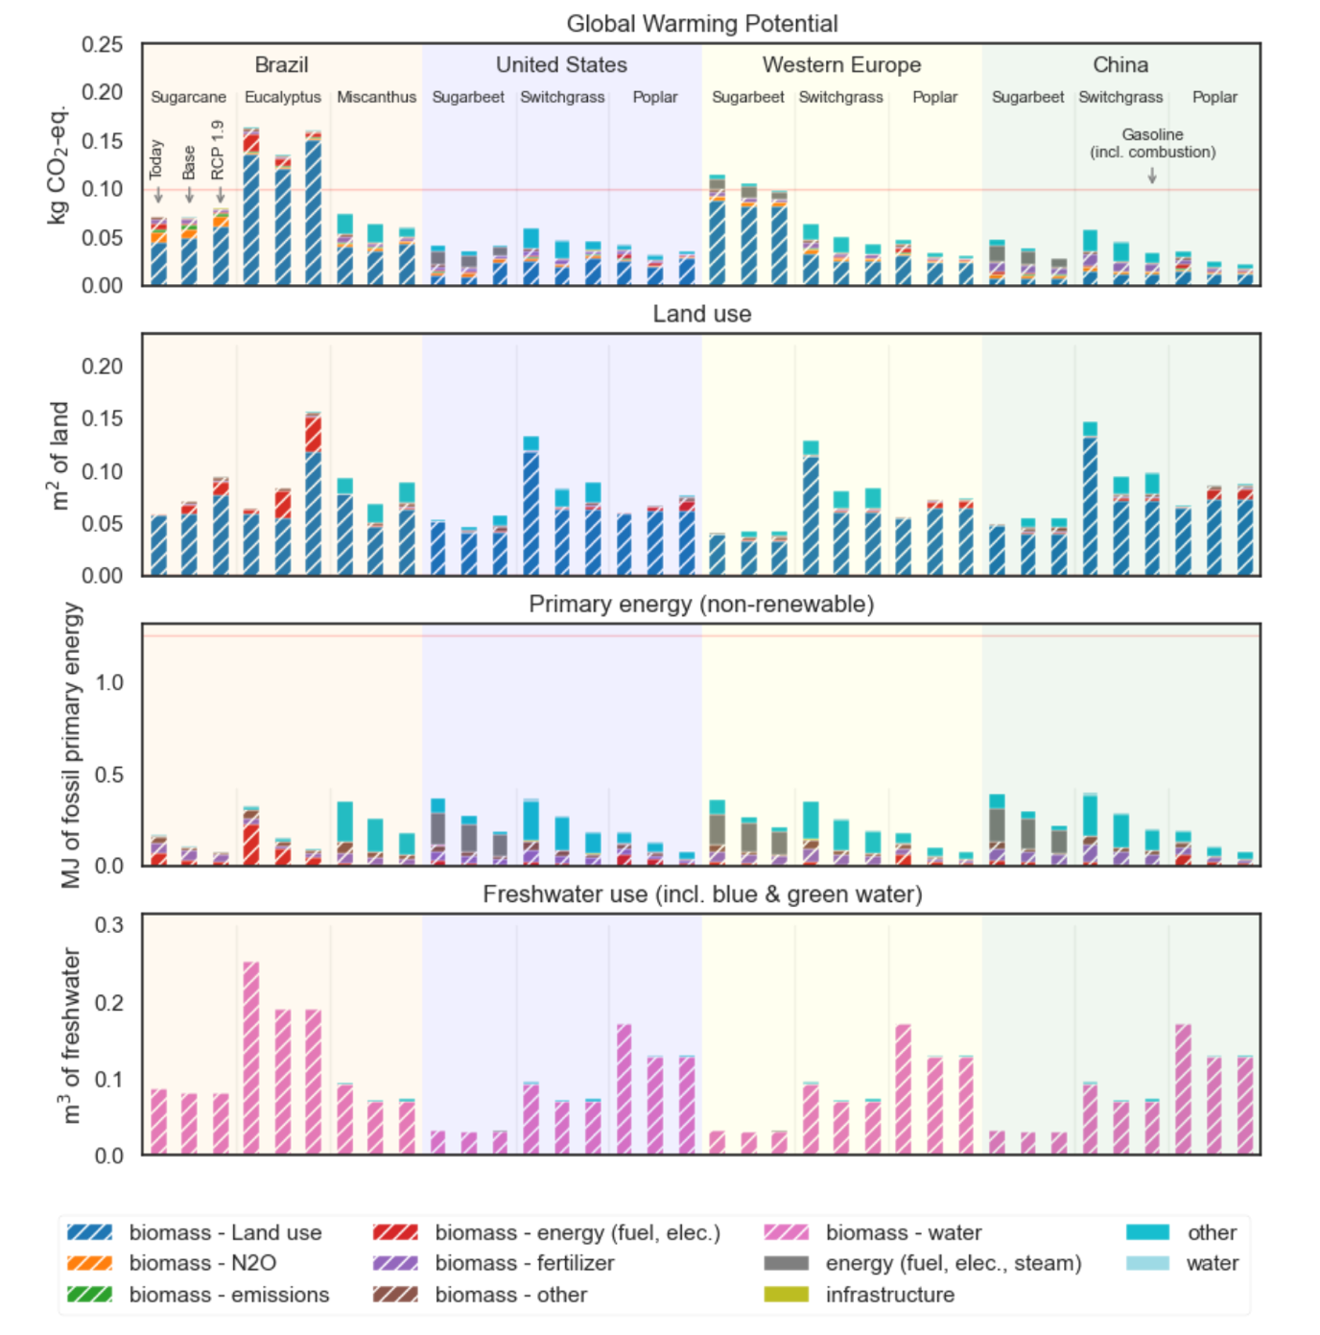
Example of transformation: BIOFUELS
(1 MJ biofuel, including combustion)

Slide 24
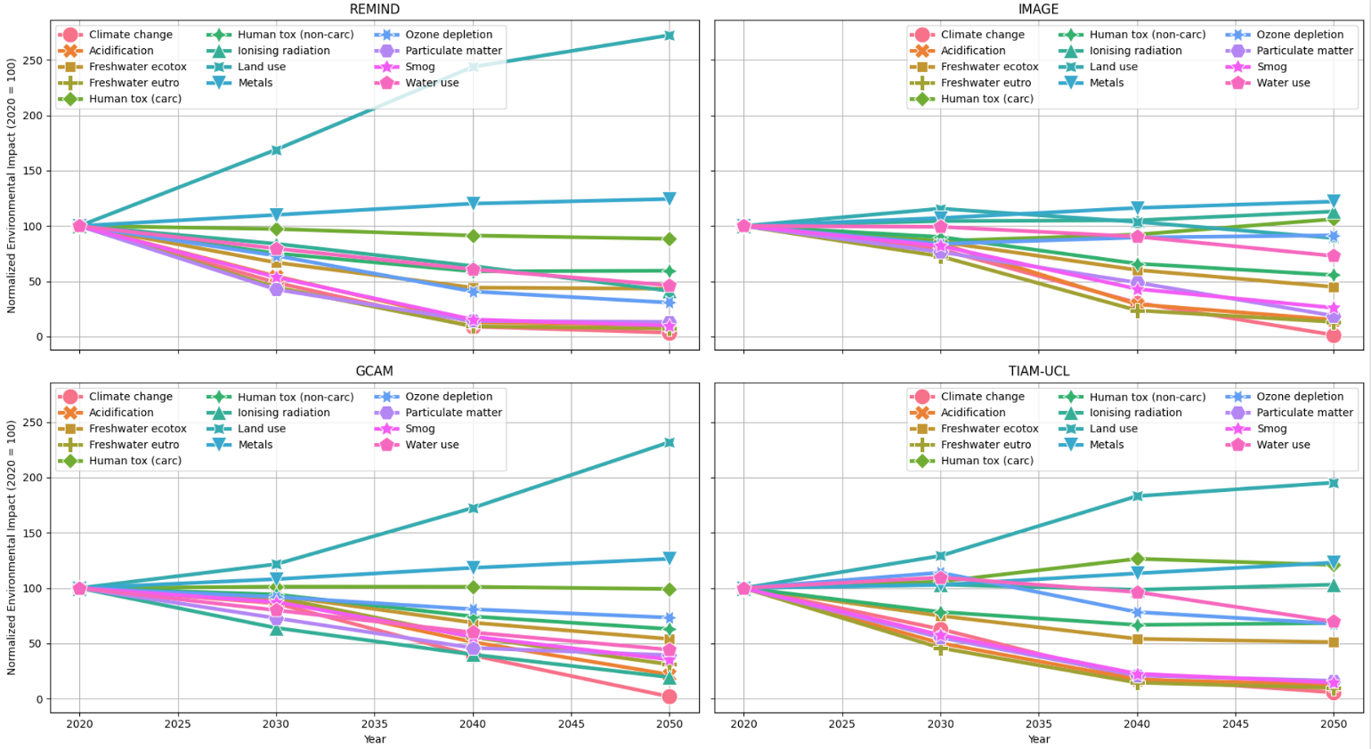
Indicators evolution across IAM models for <2 °C scenarios
Impacts of 1 kWh of global electricity, relative to 2020
GHG emissions decrease, but some resource use indicators increase.
Indicators relating to toxicity and ozone depletion are uncertain, but still relevant (e.g., what’ll happen if we do not change our current practices?).

Slide 25
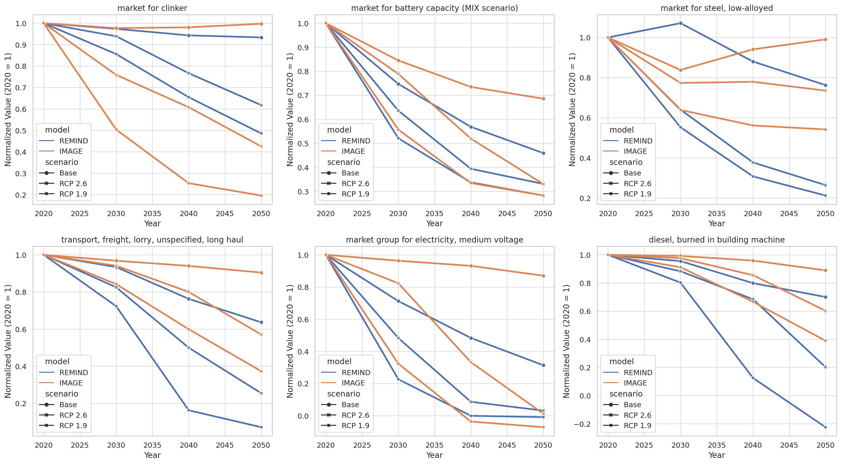
Climate change impacts across time and scenarios
Base = No climate mitigiation
RCP 2.6 = <2 °C
RCP 1.9 = 1.5 °C
Substantial impact reductions across sectors
Much is due to lower GHG per kWh of electricity and electrification
Results strongly depend on the scenario and the IAM
* Not from IAM scenario

Slide 26
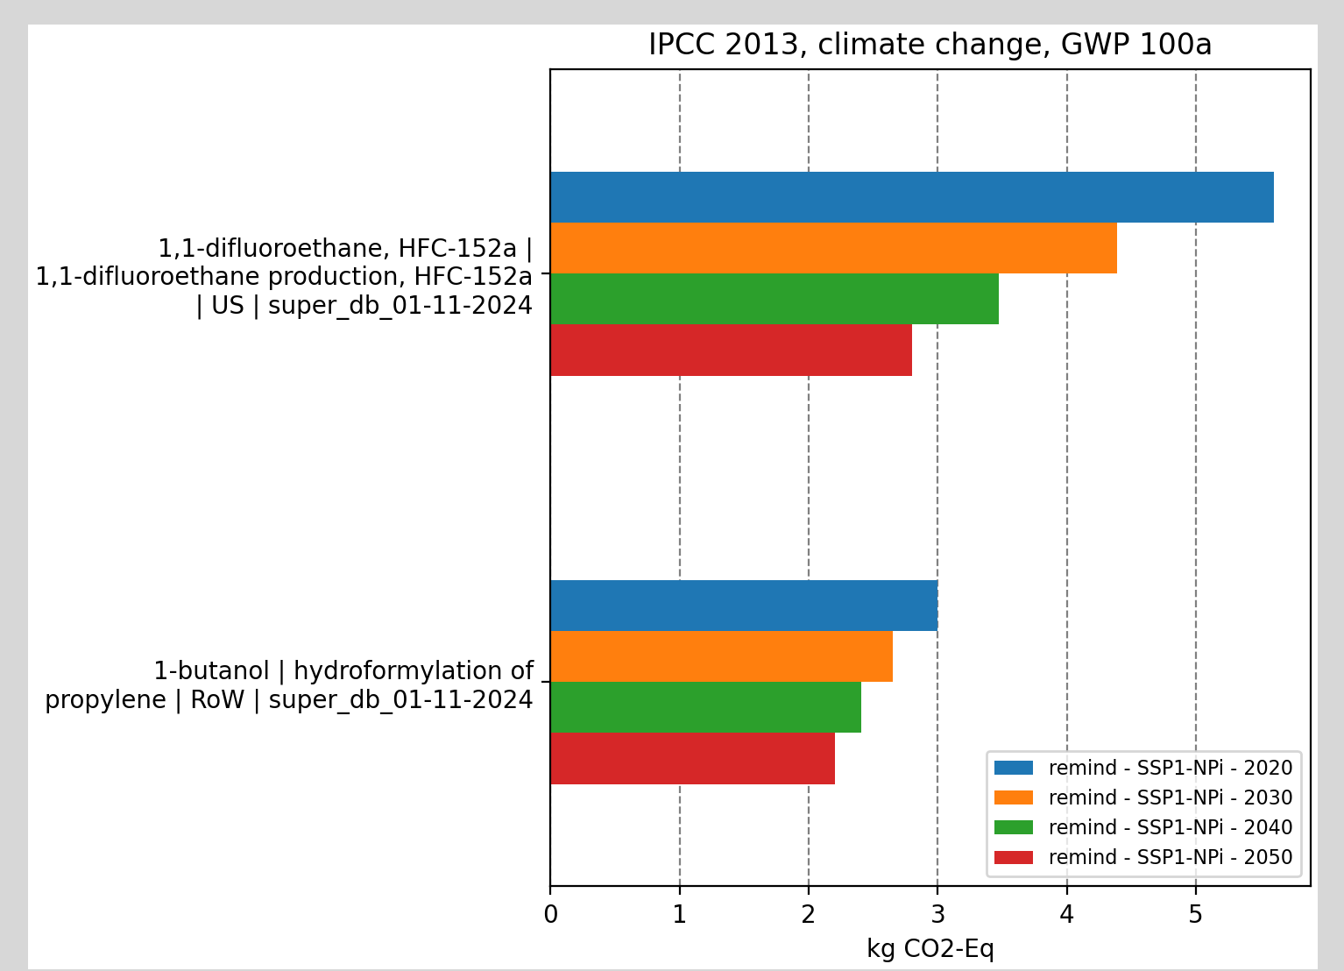
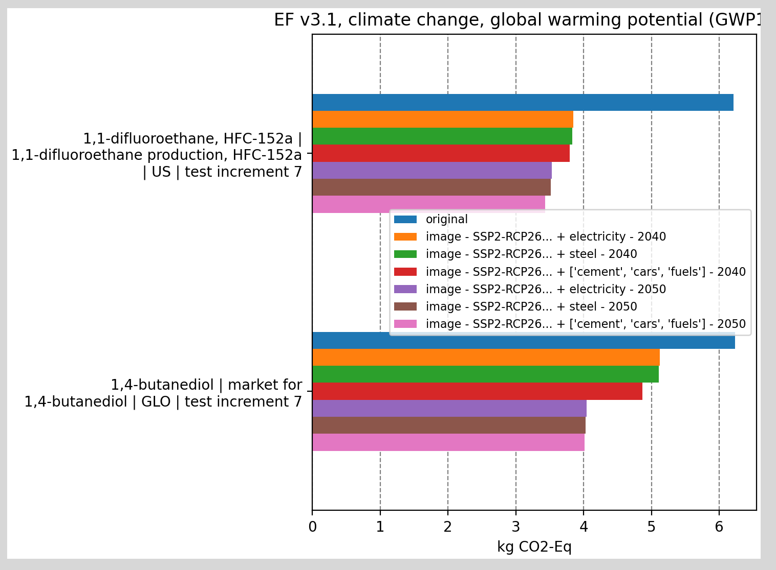
Premise in action
Scenario analysis (Superstructure database)
Sector analysis (Incremental database)

Slide 27

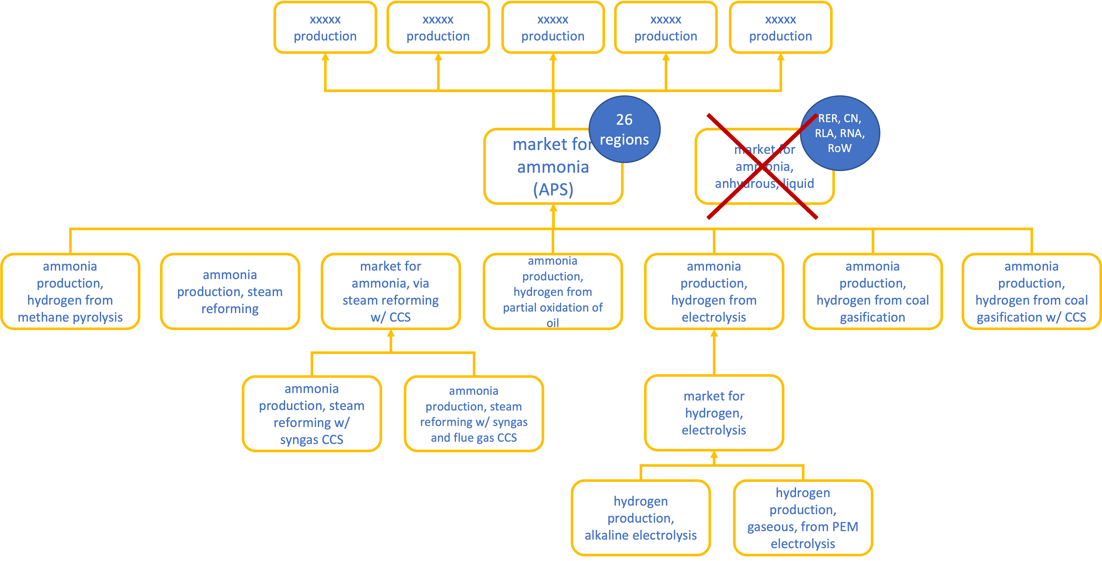
Community scenarios
Hydrogen
Cement
Cobalt
Ammonia
Net zero Swiss energy
User-defined scenario
REMIND
IMAGE
TIAM-UCL
…
https://github.com/premise-community-scenarios

Slide 28
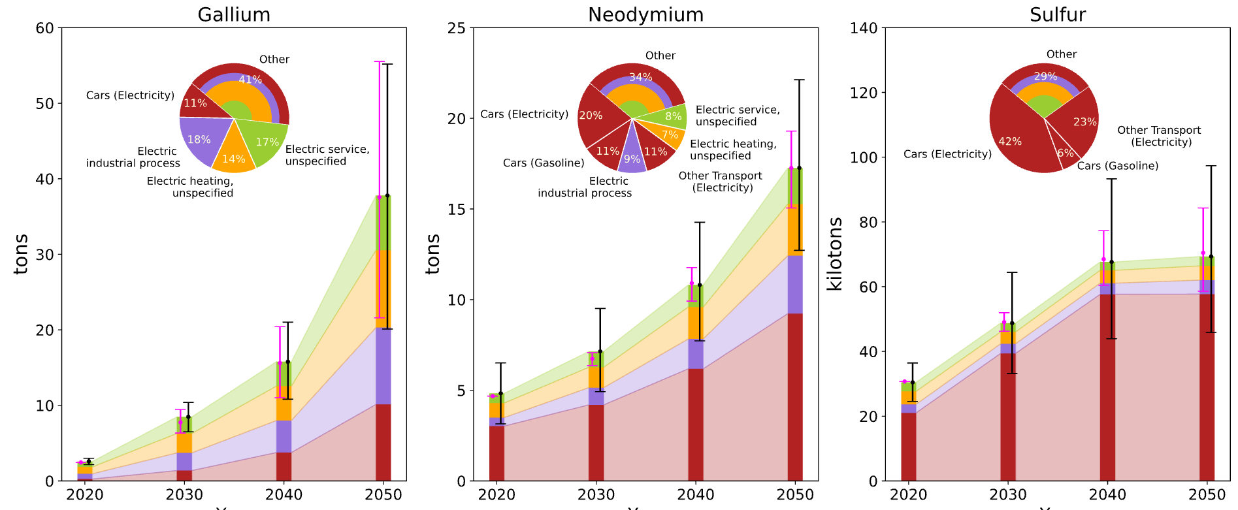
Outlook
Better representation of critical raw materials stock and flows in scenarios (MFA)
Regionalized impact assessment (GIS)
Tighter integration between Premise and IAM/Energy System Models
Further development of scenario-wide LCA (Pathways)
Scenario-wide demand for metals following Switzerland’s Net Zero scenario between 2020 and 2050.
Menacho, A., Sacchi, R., Bauer, C., Moretti, C., Panos, E. and Burgherr, P. Switzerland's net zero objective: quantifying impacts beyond borders. https://doi.org/10.21203/rs.3.rs-4915252/v1

Slide 29
CASE USING pLCA DATABASE: Electric vehicles and Metals
Climate change results for a large size battery electric car operated in Europe, using a «static», reference and <2 C REMIND energy scenarios.
Climate change results for metals, including electricity change, ore degradation, technology mix, and recycling
-30%
-42%
ferronickel
nickel
-70%
copper
zinc
lead
Harpprecht 2021
Based on Mendoza 2018
Notes:
Similar picture for the building sector, metals, chemical products…

Slide 30
CASE USING pLCA DATABASE: ammonia production (Boyce et al., 2024)
IEA ammonia scenarios + premise
GHG emissions from global ammonia production can be substantially lowered
Key factors:
future demand
supply of clean electricity
shift to green hydrogen
CCS
Key limitation:
Need for urea delays H2-based options
3-4°C
2°C
1.5°C

Slide 31
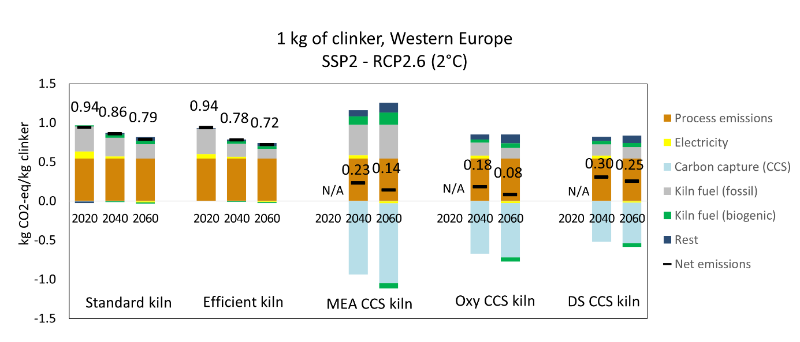
CASE USING pLCA DATABASE: cement production (Müller et al., 2024)
Based on IMAGE scenarios + premise
GHG emissions from global cement production may be substantially lower in the future
CCS is a major factor in this (next to electricity) and so there is considerable uncertainty to these results
There may also be trade-offs with other environmental impact categories

Slide 32
CASE USING pLCA DATABASE: HYDROGEN (WEI et al., 2024)
GHG emissions of one kg H2 of regional markets in 2020 and 2050. a shows GHG emissions of per kg H2 from 15 regional H2 market, as well as market share of different H2 technologies in China, USA and EU in 2020
Based on IEA H₂ scenarios + premise
Fossil fuel-based technologies have limited potential without CCS
Global H2 production grow four to eight times by 2050 but GHG emissions may already peak between 2025 and 2035.
Cumulative GHG emissions may correspond to almost 12% of the remaining carbon budget to meet the 1.5°C target.
Investments in natural gas steam methane reforming with carbon capture and storage, as projected by the IEA, lead to the risk of carbon lock-in.

Slide 33
Challenges for generating and using pLCA databases
Challenge | Description
Temporal consistency FG/BG | Ensure that the TRL and deployment foreground technology is consistent with the background scenario.
Narrative consistency FG/BG
Sectoral coverage | What are the most important sectors’ projections to integrate in LCA?
Environmental coverage | IAM and energy model projections focus on energy and climate. Non-climate impacts are less robust and consistent (e.g., biodiversity, ozone depletion).
Consistency vs. Quality/Detail | Should LCA process be 100% consistent with the scenario (efficiency, lifetime) or should we focus on completeness?
Harmonization & acceptance | Which scenarios should be considered? IPCC’s marker scenarios?
Sharing/distribution | Licensed IAM and LCA data hamper distribution.
Software | Only Brightway and Activity-Browser handle scenario-based LCA databases.
Interpretation | Exploratory scenarios, not predictions!

Slide 34


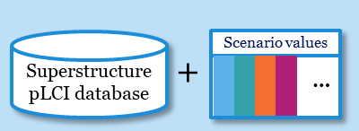
Vision: “Qualities” of pLCI databases
Best available data & models, transparent, reproducible, consistent
Broad sectoral and environmental coverage
Easy to work with in LCA software
Practitioners can easily obtain them
Generation
Sharing
Use
Scenario generators
Science-based
Useful
Accessible
Usable
LCA
practitioners
Goal:
Meaningful decision support from prospective LCA
Scenario data
Integration software
pLCI databases
LCA software
LCI database
Scenario integrators
Software providers
LCI data providers
Interpretable
Documentation & Guidance
Well-maintained
Institutions
A collaborative effort of all stakeholders is required to make this happen
Practitioners understand the scenarios
Regular updates and improvements
Steubing, B., Mendoza Beltran, A. & Sacchi, R. Conditions for the broad application of prospective life cycle inventory databases. (2023)

Slide 35
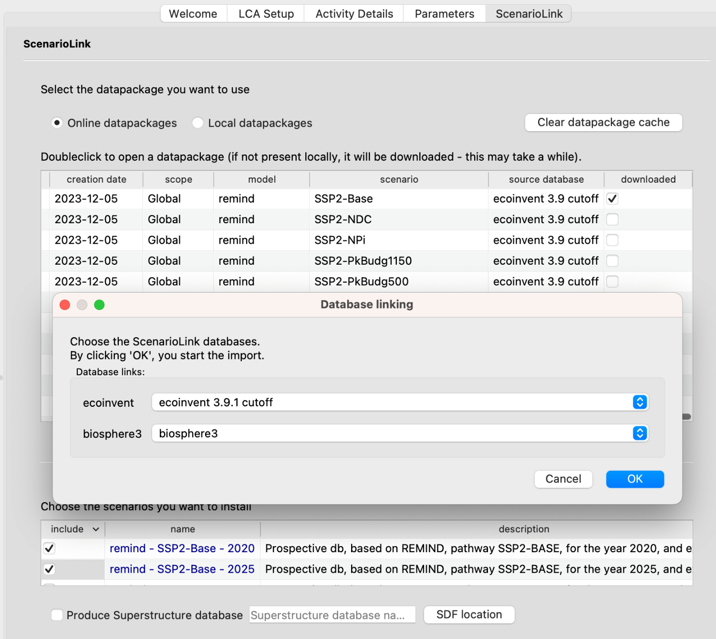


How DO I obtain premise databases?
ScenarioLink Plugin, Activity Browser
Premise databases rely on the underlying ecoinvent database: license restrictions! Two options:
1) I create my own databases
Install and get familiar with Python
Install premise
Run premise, generate databases and export in the desired format
2) I import databases via Activity Browser:
ScenarioLink plugin (you need a locally installed version of the ecoinvent database)
35

Slide 36

FUTURE DEVELOPMENTS
Heat integration
Currently, only mobile heat generators decarbonize
Metals tracking
Mining inventories for ~80 specialty metals
MFA → recycling rates, ore degradation
Scenarios from three additional IAMs
Message-ix, Ti-IAM, GCAM
pathways
A new library for scenario- or sector-wide pLCA

Slide 37








PATHWAYS: System-wide prospective LCA
Data coupling
Data package
Premise outputs data packages containing scenario-adjusted inventories for each time step
Pathways reads data packages and returns impacts by scenario variable (final energy consumer), life-cycle activity, the origin of impacts, and year.
Scenario
Meta data
1
2
database
Scenario
Mapping
Processing
3
2000
4
5
6
Additional inventories
A
B
2100
A
B

Slide 38
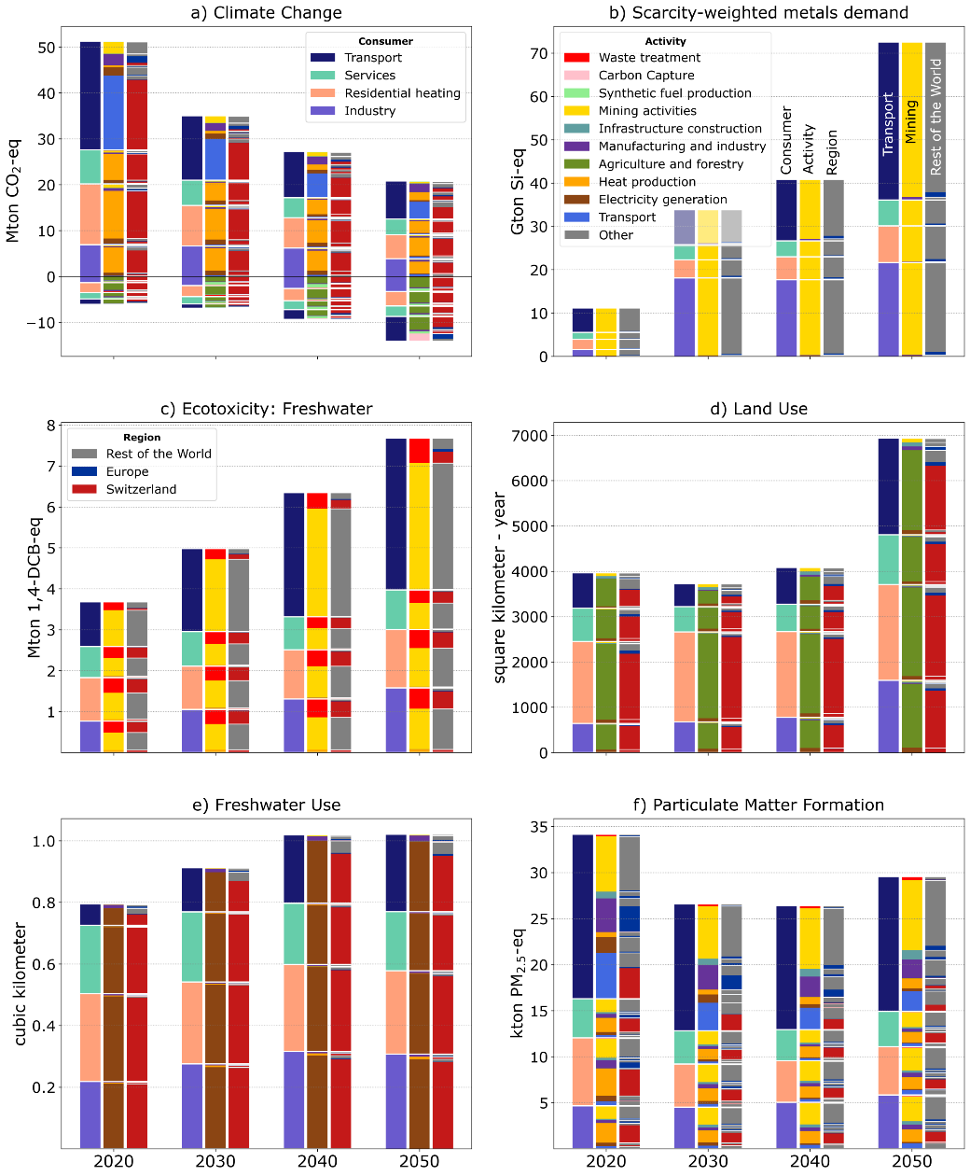
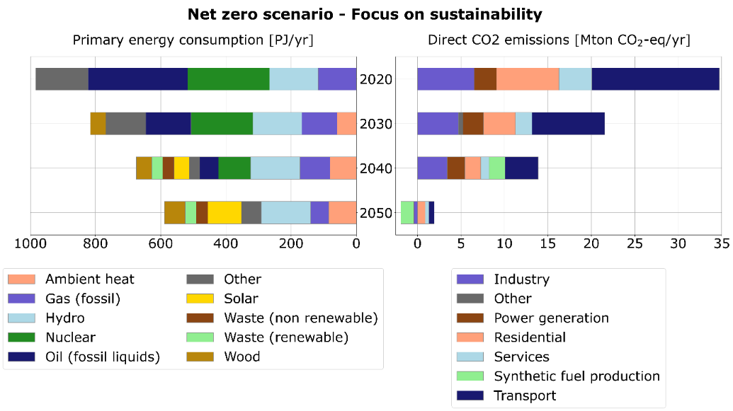
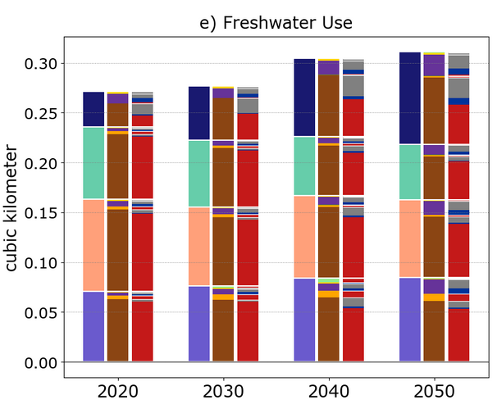
PATHWAYS: Swiss Final Energy supply
1
2
38

Slide 39
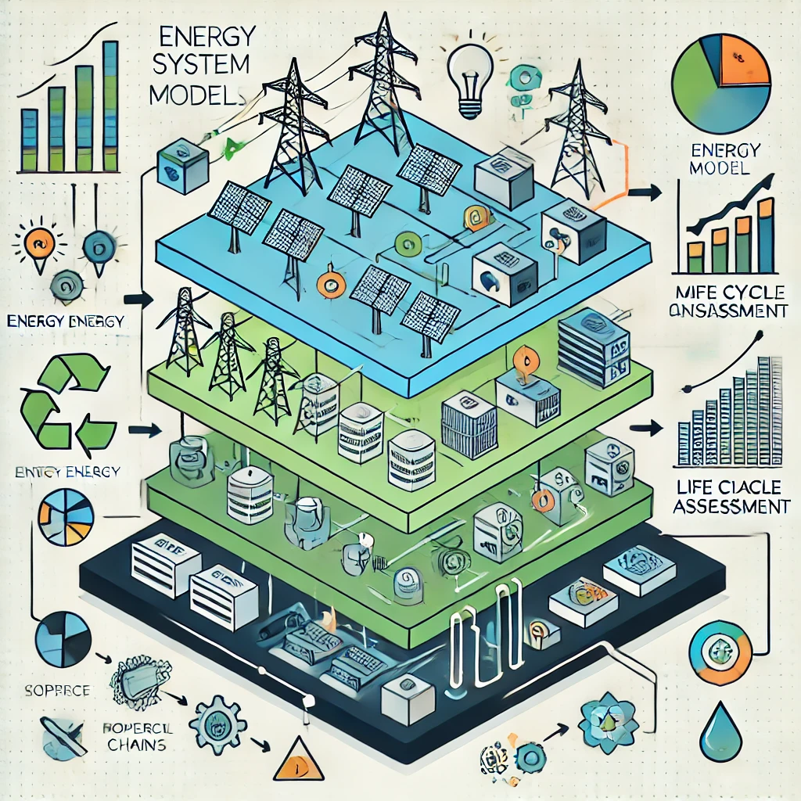
Conclusions
Good scenarios matter! For LCA results, for stakeholder opinions, and for decision-making. Important to get this right!
The systematic generation of pLCA databases is an exciting and important development for prospective LCA.
pLCA databases are increasingly being used (at least in academia).
Much work remains to improve these databases and prepare them for wider use in LCA practice – collaborative effort is needed!
LIFE CYCLE ASSESSMENT
ENERGY SOURCES
CIRCULARITY
IMPACT ASSESSMENT
SUPPLY CHAINS

Slide 40
Links to open-source tools
Brightway2 (LCA framework): https://github.com/brightway-lca
Activity-Browser (GUI for Brightway): https://github.com/LCA-ActivityBrowser/activity-browser
Brightway-superstructure (superstructure approach): https://github.com/LCA-ActivityBrowser/brightway-superstructure
wurst (systematic transformation of LCA databases): https://github.com/polca/wurst
premise (IAM-LCA coupling): https://github.com/polca/premise
Pathways (system-wide pLCA): https://github.com/polca/pathways

Slide 41
Selected references
Methodology
Sacchi R, Terlouw T, Siala K, Dirnaichner A, Bauer C, Cox B, Mutel C, Daioglou V, Luderer G (2022) PRospective EnvironMental Impact asSEment (premise): A streamlined approach to producing databases for prospective life cycle assessment using integrated assessment models Renewable Sustainable Energy Rev 160:112311 doi:https://doi.org/10.1016/j.rser.2022.112311
Mendoza Beltran A, Cox B, Mutel C, van Vuuren DP, Font Vivanco D, Deetman S, Edelenbosch OY, Guinée J, Tukker A (2018) When the Background Matters: Using Scenarios from Integrated Assessment Models in Prospective Life Cycle Assessment J Ind Ecol doi:10.1111/jiec.12825
Steubing B, de Koning D (2021) Making the use of scenarios in LCA easier: the superstructure approach Int J Life Cycle Assess 26:2248-2262 doi:10.1007/s11367-021-01974-2
Use of broad future scenarios (list not comprehensive)
Cox B, Mutel CL, Bauer C, Mendoza Beltran A, van Vuuren DP (2018) Uncertain Environmental Footprint of Current and Future Battery Electric Vehicles Environ Sci Technol 52:4989-4995 doi:10.1021/acs.est.8b00261
Cox B, Bauer C, Mendoza Beltran A, van Vuuren DP, Mutel CL (2020) Life cycle environmental and cost comparison of current and future passenger cars under different energy scenarios Applied Energy 269:115021 doi:https://doi.org/10.1016/j.apenergy.2020.115021
Harpprecht C, Oers L, Northey SA, Yang Y, Steubing B (2021) Environmental impacts of key metals' supply and low‐carbon technologies are likely to decrease in the future J Ind Ecol 25:1543-1559 doi:10.1111/jiec.13181
van der Meide M, Harpprecht C, Northey S, Yang Y, Steubing B (2022) Effects of the energy transition on environmental impacts of cobalt supply: A prospective life cycle assessment study on future supply of cobalt J Ind Ecol n/a doi:https://doi.org/10.1111/jiec.13258
Li C, Mogollón JM, Tukker A, Dong J, von Terzi D, Zhang C, Steubing B (2022) Future material requirements for global sustainable offshore wind energy development Renewable Sustainable Energy Rev 164:112603 doi:https://doi.org/10.1016/j.rser.2022.112603
Xu C, Steubing B, Hu M, Harpprecht C, van der Meide M, Tukker A (2022) Future greenhouse gas emissions of automotive lithium-ion battery cell production Resources, Conservation and Recycling 187:106606 doi:https://doi.org/10.1016/j.resconrec.2022.106606
Zhong X, Hu M, Deetman S, Steubing B, Lin HX, Hernandez GA, Harpprecht C, Zhang C, Tukker A, Behrens P (2021) Global greenhouse gas emissions from residential and commercial building materials and mitigation strategies to 2060 Nature Communications 12:6126 doi:10.1038/s41467-021-26212-z
Yang X, Hu M, Tukker A, Zhang C, Huo T, Steubing B (2022) A bottom-up dynamic building stock model for residential energy transition: A case study for the Netherlands Applied Energy 306:118060 doi:https://doi.org/10.1016/j.apenergy.2021.118060
Dirnaichner, A. et al. Life-cycle impacts from different decarbonization pathways for the European car fleet. Environ. Res. Lett. 17, 044009 (2022).
Sacchi, R., Bauer, C., Cox, B. & Mutel, C. When, where and how can the electrification of passenger cars reduce greenhouse gas emissions? Renew. Sustain. Energy Rev. 162, 112475 (2022).
Sacchi, R., Bauer, C. & Cox, B. L. Does Size Matter? The Influence of Size, Load Factor, Range Autonomy, and Application Type on the Life Cycle Assessment of Current and Future Medium? The Heavy-Duty Vehicles. Environ. Sci. Technol. 55, 5224–5235 (2021).
Ueckerdt, F. et al. Potential and risks of hydrogen-based e-fuels in climate change mitigation. Nat. Clim. Chang. 2021 115 11, 384–393 (2021).
Watanabe, M. D. B., Cherubini, F. & Cavalett, O. Climate change mitigation of drop-in biofuels for deep-sea shipping under a prospective life-cycle assessment. J. Clean. Prod. 364, 132662 (2022).
Gibon, T., Menacho, À. & Guiton, M. Carbon Neutrality in the UNECE Region: Integrated Life-cycle Assessment of Electricity Sources UNITED NATIONS ECONOMIC COMMISSION FOR EUROPE. https://unece.org/sites/default/files/2022-04/LCA_3_FINAL March 2022.pdf (2021).
Cavalett, O., Watanabe, M. D. B., Fleiger, K., Hoenig, V. & Cherubini, F. LCA and negative emission potential of retrofitted cement plants under oxyfuel conditions at high biogenic fuel shares. Sci. Reports 2022 121 12, 1–14 (2022).
Dávila, J., Sacchi, R. & Pizzol, M. Preconditions for CCUS to deliver climate neutrality in cement production. Appl. Energy.
Lamers, P., Ghosh, T., Upasani, S., Sacchi, R. & Daioglou, V. Linking life cycle and integrated assessment modeling to evaluate technologies in an evolving system context: a Power-to-Hydrogen case study for the United States. Environ. Sci. Technol.
Strathoff, P. et al. On the Design and Sustainability of Commuter Aircraft with Electrified Propulsion Systems. AIAA Aviat. 2022 Forum (2022) doi:10.2514/6.2022-3738.

Slide 42
Learn more about PSI-LEA at https://www.psi.ch/en/lea.
Learn more about ETH-ESA at
https://esa.ethz.ch/.

